Slide 1
Customer Behaviour analytics
Tharun
Guide : Azra Mam

Slide 2
Problem Statements
1. Which category and items generate the highest revenue?
2. How does customer gender split affect spending patterns?
3. Which season drives the most revenue?
4. Which locations contribute the most to total revenue?
5. Does payment method influence total revenue generated?
6. Does subscription status impact customer spending?
7. Which shipping type do customers prefer most?
8. How does purchase frequency relate to customer value?
9. Does gender affect category-wise spending differently?

Slide 3
Dataset overview
Customer Shopping Behavior · Shop Sense Analytics
5,050
Total Customers
17
Variables
$650,583
Total Revenue
18 – 70
Age Range
Category breakdown
Category 5 (Clothing, Accessories, Outerwear, Electronics, Footwear)
Gender 3 (Female, Male, Other)
Season 5 (Winter, Spring, Fall, Summer, Autumn)
Items purchased 30 unique items
Locations 54 unique locations
Shopping behavior fields
Payment method 6 types
Shipping type 6 types
Purchase frequency 7 types
Subscription status Yes / No
Discount applied Yes / No
All 17 columns
Customer ID, Age , Gender, Item Purchased ,Category, Purchase Amount, Location, Size ,Color, Season ,Review Rating ,Subscription Status ,Shipping Type ,Discount Applied ,Previous Purchases, Payment Method ,Frequency of Purchases

Slide 4
Methodology
📊
Excel
→
🗄️
SQL
→
🐍
EDA (Python)
→
📈
Power BI
1
Data collection
Raw dataset gathered — Customer Shopping Behavior (5,050 rows, 17 columns)
2
Data cleaning (Excel)
Missing values identified and treated
Column names and formats standardized
Cleaned dataset prepared for export
3
SQL database (PostgreSQL)
BEHAVIOUR table created with Customer ID as primary key
Cleaned data exported from Excel into SQL table
4
SQL querying
Queries run to validate data and check for nulls
COUNT and aggregate checks on Purchase Amount

Slide 5
5
EDA (Python)
Cleaned Excel dataset used for analysis
Category, spending, and rating trends explored
Correlations and key patterns identified
6
Power BI dashboard
Cleaned data imported and relationships built
Two story-driven dashboards designed
KPIs, slicers and interactive visuals added

Slide 6
EDA insights
Shop Sense Analytics · Key findings from Customer Shopping Behavior dataset
Clothing & Accessories dominate volume
Highest purchase counts overall — Electronics, Footwear, and Outerwear remain niche segments.
Most spend $40–$80 per purchase
Purchase amounts spread $20–$100 with outliers past $1000+ — moderate spending is the norm.
Age doesn't predict spending
No strong link between age and purchase amount — all age groups spend $20 to $1000+ similarly.
Electronics commands premium pricing
Median purchase $884–$1282 — far above Clothing/Accessories at $20–$95.
Satisfaction stays consistent
All categories rate 3.0–4.0 — Accessories & Footwear edge slightly higher than Electronics.
Subscribers spend 5% more
Avg $303 vs $289 for non-subscribers — subscription benefits drive larger baskets.
Digital payments dominate
Debit Card & PayPal lead adoption — Bank Transfer and Venmo trail behind.

Slide 7
Dashboard demonstration

Slide 8
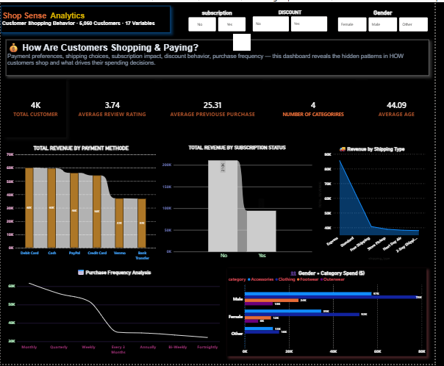

Slide 9
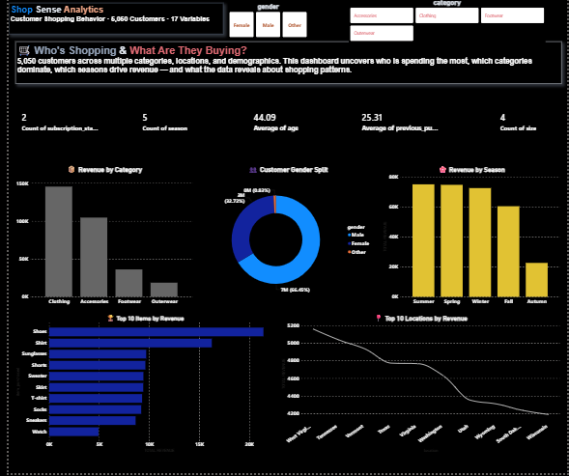
MARKET OVERVIEW
$3 Billion
$1 Billion
$2 Billion
Freedom to invent
Selectively inclusive market
Serviceable available market
Opportunity to build
Fully inclusive market
Total addressable market
Few competitors
Specifically targeted market
Serviceable obtainable market

Slide 10
Dashboard insights ShopSense Analytics · Calculated findings from both dashboards
Dashboard 1 — Who's Shopping
👔Male customers dominate at 64.65%
Nearly 2.8x more than Female (22.72%) — heavily male-skewed base.
☀️Summer revenue is ~3x Autumn
$60K vs $22K — clear seasonal spike, Spring/Winter sit mid-range.
👟Shoes lead items by 6x
$30K vs Watch at $5K — footwear & apparel are the strongest sellers.
👗Clothing edges Accessories by 14%
$160K vs $140K — top 2 categories nearly tied, others trail far behind.
📍Locations are evenly spread
Only ~20% gap between #1 and #10 city — unlike category concentration.
Dashboard 2 — How They Pay
🔔Subscribers generate 4x more revenue
$80K vs $20K for non-subscribers — strongest revenue lever found.
💳Debit Card beats Bank Transfer by 75%
$28K vs $16K — customers prefer quick, direct payment methods.
🚀Express shipping leads at 27.64%
More than 2x Store Pickup (13.22%) — speed wins over cost.
📅Quarterly & Weekly buyers lead, 5x smallest
~32% combined share — customers shop in consistent cycles.
⚖️Males outspend females by ~60%
In Accessories alone — same pattern repeats across all categories.

Slide 11
Business recommendations

Slide 12
Growth strategy
Feb 20XX
Roll out product to high profile or top-level participants to help establish the product
Mar 20XX
Release the product to the general public and monitor press release and social media accounts
Oct 20XX
Gather feedback and adjust product design as necessary

Slide 13
TRACTION
Forecasting for success
Key Metrics
 | Clients | Orders | Gross revenue | Net revenue
20XX | 10 | 1100 | $10,000 | $7,000
20XX | 20 | 200 | $20,000 | $16,000
20XX | 30 | 300 | $30,000 | $25,000
20XX | 40 | 400 | $40,000 | $30,000
REVENUE BY YEAR

Slide 14
TWO-YEAR ACTION PLAN
DRAFT BLUEPRINTS
GATHER FEEDBACK
DELIVER TO CLIENT
20XX
JAN
FEB
MAR
APR
MAY
JUN
JUL
AUG
SEP
OCT
NOV
DEC
20XX
JAN
FEB
MAR
APR
MAY
JUN
JUL
AUG
SEP
OCT
NOV
DEC
RUN FOCUS GROUPS
TEST DESIGN
LAUNCH DESIGN

Slide 15
FINANCIALS
 | Year 1 | Year 2 | Year 3
INCOME
Users | 50,000 | 400,000 | 1,600,000
Sales | 500,000 | 4,000,000 | 16,000,000
Average price per sale | 75 | 80 | 90
Revenue @ 15% | 5,625,000 | 48,000,000 | 216,000,000
GROSS PROFIT | 5,625,000 | 48,000,000 | 216,000,000
Expenses
Sales & marketing | 5,062,500 | 38,400,000 | 151,200,000 | 70%
Customer service | 1,687,500 | 9,600,000 | 21,600,000 | 10%
Product development | 562,500 | 2,400,000 | 10,800,000 | 5%
Research | 281,250 | 2,400,000 | 4,320,000 | 2%
TOTAL EXPENSES | 7,593,750 | 52,800,000 | 187,920,000

Slide 16




MEET THE TEAM
TAKUMA HAYASHI​
MIRJAM NILSSON​
FLORA BERGGREN​
RAJESH SANTOSHI​
President
Chief Executive Officer
Chief Operations Officer
VP Marketing

Slide 17








MEET THE TEAM
TAKUMA HAYASHI
MIRJAM NILSSON​
FLORA BERGGREN​
RAJESH SANTOSHI
President
Chief Executive Officer
Chief Operations Officer
VP Marketing
GRAHAM BARNES
ROWAN MURPHY
ELIZABETH MOORE
ROBIN KLINE
VP Product
SEO Strategist
Product Designer
Content Developer

Slide 18
FUNDING
$14,000
$12,000
$82,000
$32,000
ANGEL INVESTMENTS
PROPERTY
SHARES
CASH
Amount obtained through other investors
Revenue obtained from property rentals
Number of shares converted into USD
Liquid cash we have on hand

Slide 19
SUMMARY
At Contoso, we believe in giving 110%. By using our next-generation data architecture, we help organizations virtually manage agile workflows. We thrive because of our market knowledge and great team behind our product. As our CEO says, "Efficiencies will come from proactively transforming how we do business.”

Slide 20
THANK YOU
Mirjam Nilsson​
206-555-0146
mirjam@contoso.com
www.contoso.com

